Slide 1
Greedy approach
Knap sack Problem
Minimal spanning Tree
Prim’s Algorithm
Kruskal Algorithm
Optimal Storage on Tapes
Single source shortest path

Slide 2

Storage Tapes

Slide 3
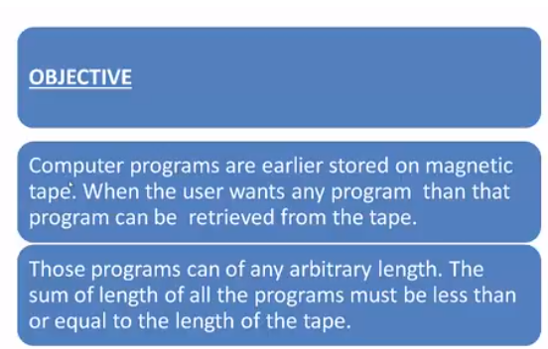

Slide 4
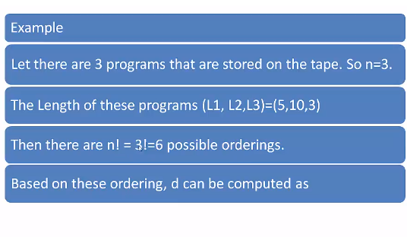

Slide 5
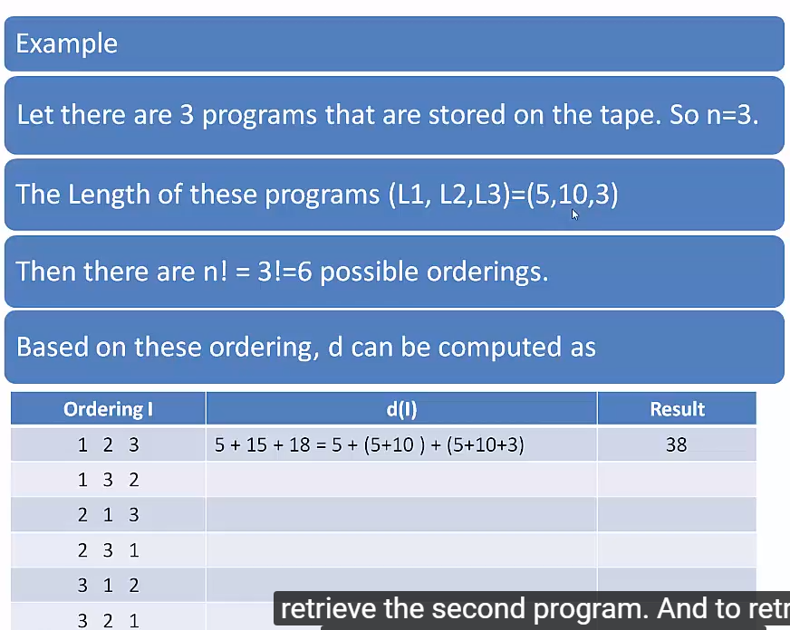

Slide 6
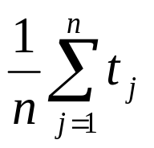
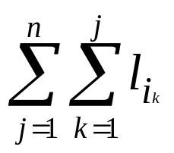
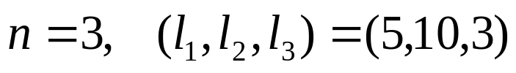
The goal is to minimize MRT (Mean Retrieval Time),
i.e. want to minimize
Ex:
There are n! = 6 possible orderings for storing them.
order
total retrieval time
MRT
1
2
3
4
5
6
1 2 3
1 3 2
2 1 3
2 3 1
3 1 2
3 2 1
5+(5+10)+(5+10+3)=38
5+(5+3)+(5+3+10)=31
10+(10+5)+(10+5+3)=43
10+(10+3)+(10+3+5)=41
3+(3+5)+(3+5+10)=29
3+(3+10)+(3+10+5)=34
38/3
31/3
43/3
41/3
29/3
34/3
Smallest

Slide 7
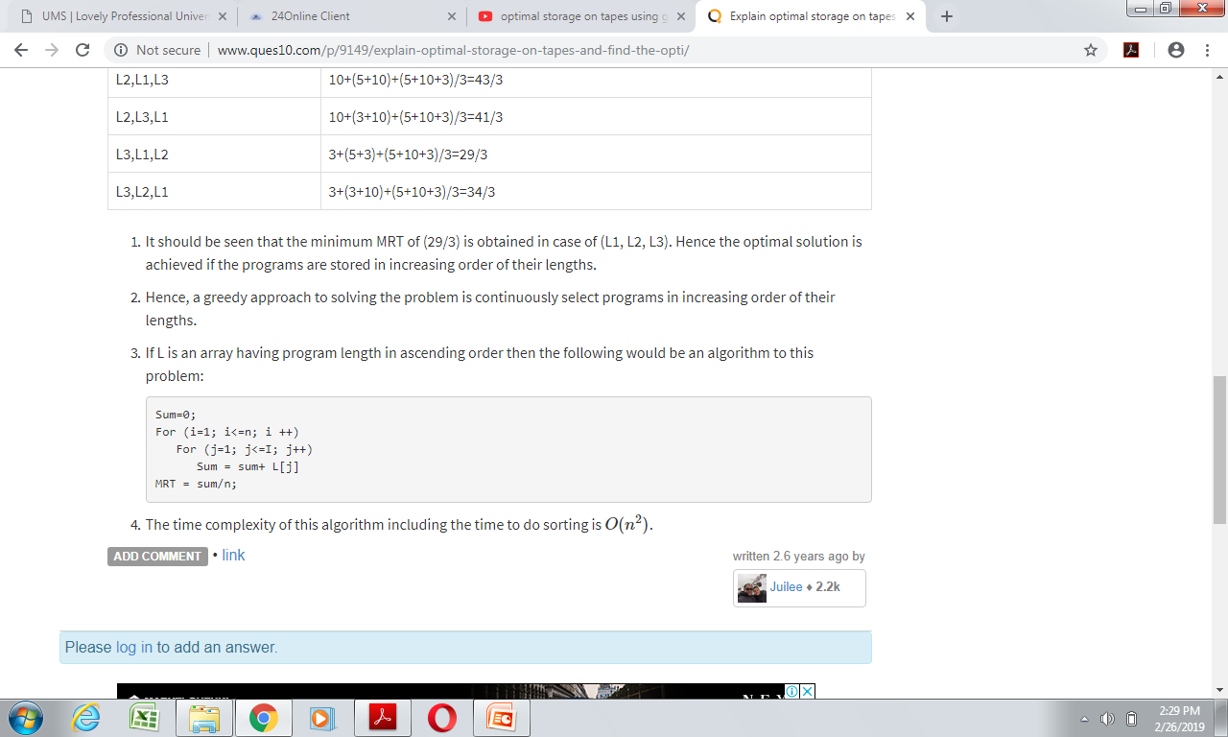
Hence, a greedy approach to solving the problem is continuously select programs in increasing order of their lengths.
Sum=0;
For (i=1; i<=n; i ++)
For (j=1; j<=I; j++)
Sum = sum+ L[j]
MRT = sum/n;

Slide 8
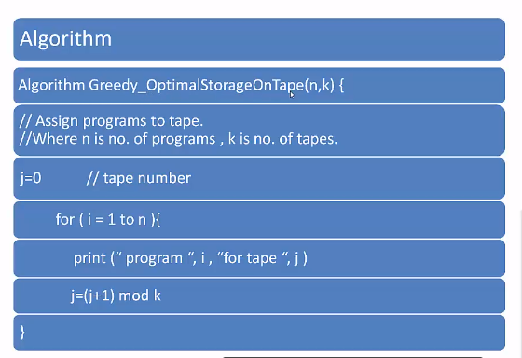

Slide 9
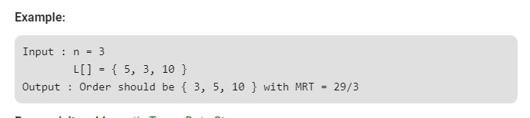

Slide 10
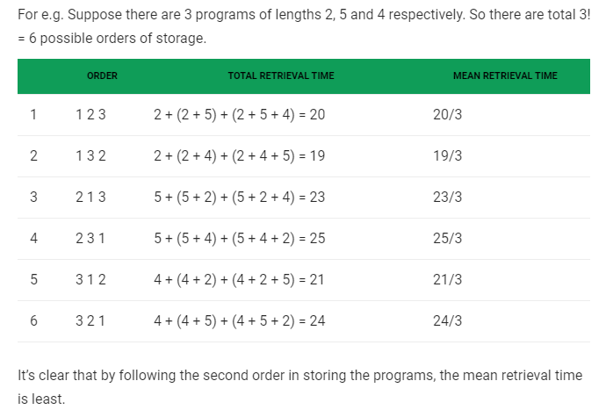

Slide 11
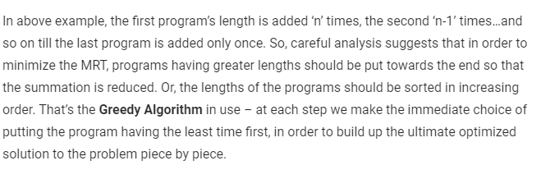

Slide 12
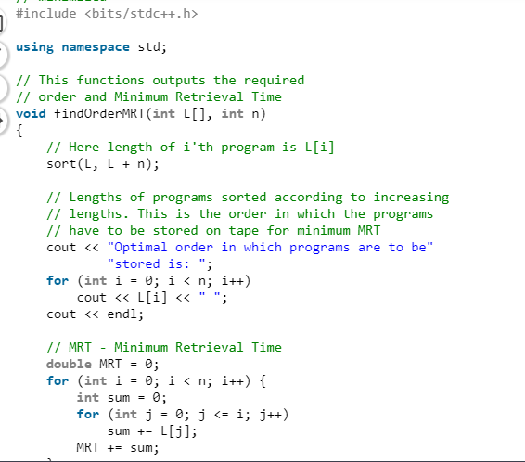

Slide 13
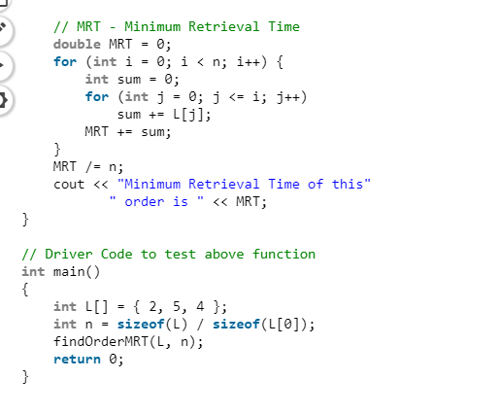

Slide 14
________________ is also called auxiliary storage.
a) secondary memory
b) tertiary memory
c) primary memory
d) cache memory

Slide 15
Magnetic tape is a type of _________ access device.
a) Sequential
b) Direct access
c) Step
d) Indirect

Slide 16
The magnetic tape is generally a plastic ribbon coated with ______
a) Magnesium oxide
b) Chromium dioxide
c) Zinc oxide
d) Copper oxide

Slide 17
Plastic ribbon is coated with a magnetizable recording material. Iron oxide and chromium dioxide is generally used in magnetic tapes. Data are recorded on the tape in the form of tiny invisible dots.

Slide 18
The dots on the magnetic tape represent ________
a) Binary digits
b) Decimal digits
c) Hex digits
d) Oct digits

Slide 19
Which of the following is the correct representation for a storage capacity of a tape?
a) Data recording density = Storage capacity
b) Length = Storage capacity
c) Storage capacity= Length * data recording density
d) Storage capacity= Length + data recording density

Slide 20
Explanation: Storage capacity is nothing but the product of length and the data recording density. Magnetic tape is commonly used sequential-access secondary device. Data recording density is measured in bytes per inch.

Slide 21
__________________ is the amount of data that can be stored on a given length of tape.
a) Storage capacity
b) Length
c) Data recording density
d) Tape density

Slide 22
Data recording density is the amount of data that can be stored on a given length of the tape. It is measured in bytes per inch. Bytes per inch=bpi.

